Slide 1

Evolution of the Three Point Shot
Cole Fingerut Chris Hanafin
Chris Mikus
Sarah Schulte

Slide 2
Data, Methodology, and Questions
“
There are many reasons for the rise of the 3-point shot, but one may simply be math. It took a while, but coaches finally stopped listening to the traditionalist naysayers and realized that a shot that is worth 50 percent more pays off, even if that shot is a little harder to make.
”
-Victor Mather, New York Times
CSV: Annual NBA Player Data (1950-2018)
API: SportsReference NBA
How has the changing attitude towards shooting three-point attempts affected the way game is played?
“Dream Teams” are rarely on the court during the same seasons (or even eras). How, using data, can we compare these teams more comprehensively?
Our CSV: Annual NBA Franchise and Player Data (1990-2017)
Jupyter Notebook pd.merge(on = “Team”)*
CSV: Annual NBA Team Data (1946-2017)

Slide 3
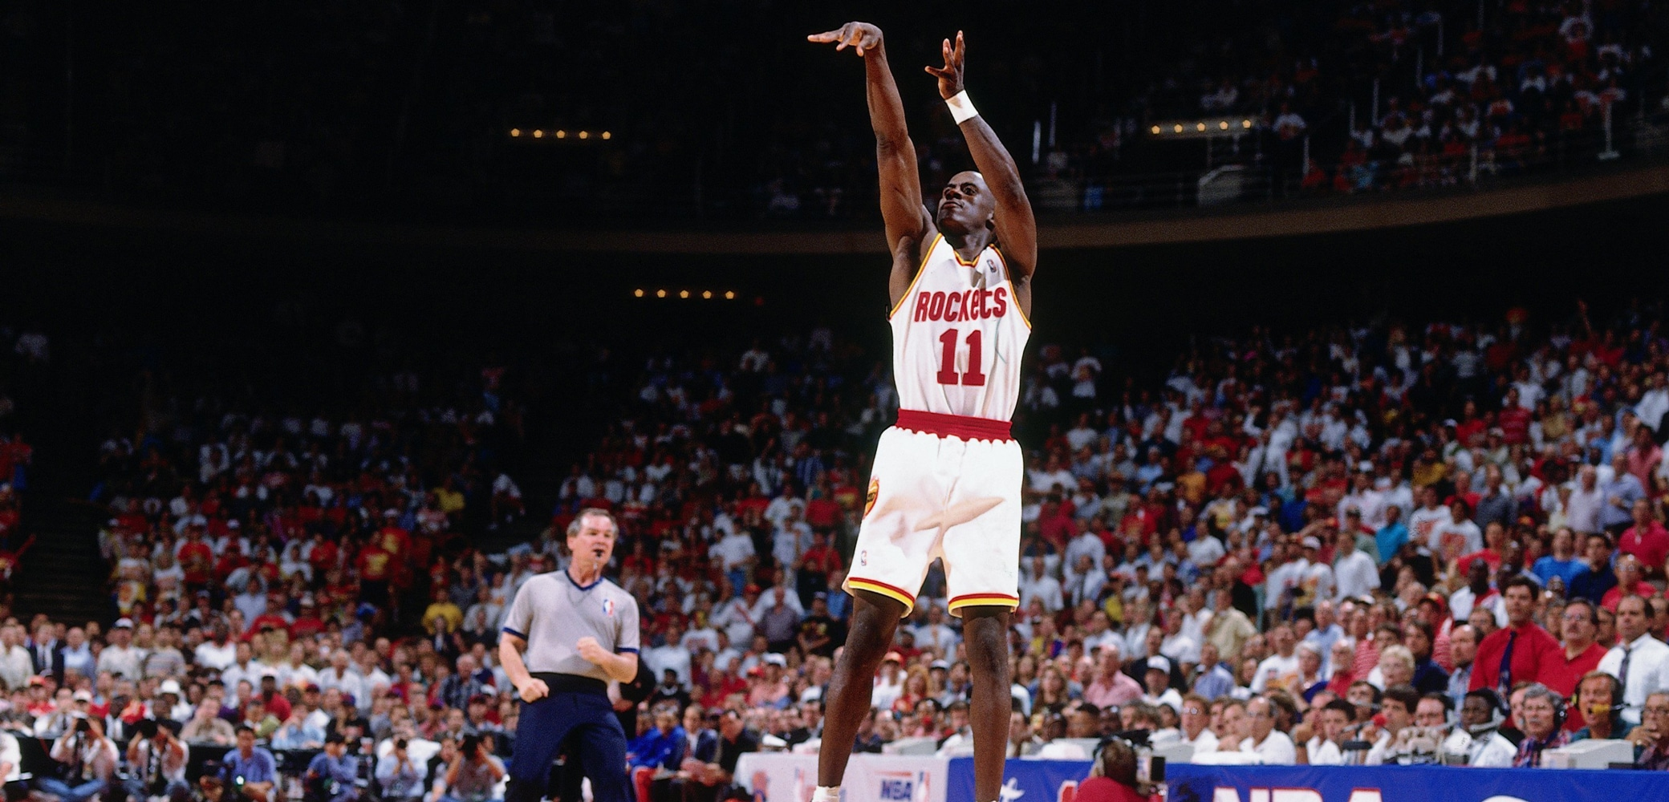
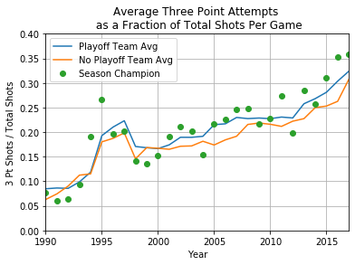
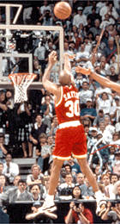
A Shot in the Dark: Three Point Shooting Rates are Increasing
The entire NBA (both teams that made and missed the season playoffs) is shifting towards a strategy of higher rates of three-point attempts as a fraction of total shots.
Since the mid-1990s, teams that shoot a higher percentage of their shots from behind the three-point line are enjoying an increased probability of a playoff appearance.
Observations from the visual:
Kenny Smith and Vernon Maxwell (pictured) helped the Houston Rockets win consecutive championships in 1994 and 1995 with three-point attempts well above league average.
For the 1997-98 season, NBA Official Regulation permanently increased the distance of the three-point line from 22 ft. to its current value of 23 ft. 9 in.
1
2
Notes:
Note: Three-point attempts only indicate the number of shots taken, and does not indicate the number of shots that actually go into the basket. We can see here that simply shooting more threes - regardless of whether or not they actually result in points - is already a viable strategy (although making the shots is always a bonus).

Slide 4
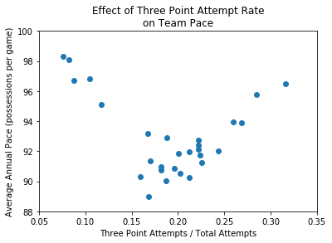
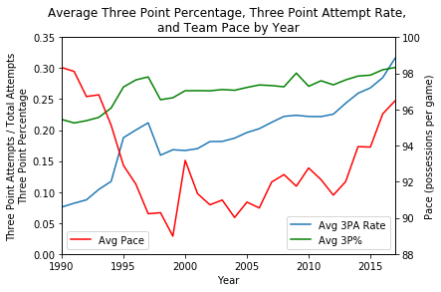
All or Nothing: Caveat to Increased Three-point Shooting
NBA teams must commit to a significant increase in three-point shooting in order to see a “return on investment” in their three-point shooting.
As teams shoot more threes, the number of possessions per game - the amount of times a team is in control of the ball and thus capable of scoring points - is decreased.
Observations from the visual:
Game pace (possessions per game) stops decreasing as a function of three-point attempt percentage when around 21% of all shots come from behind the arc.
The effect of the increase in the three-point line during the 1997-98 season is still apparent, and it took nearly a decade before teams attempted three-pointers at the same rate.
1
1
2
Notes:
We saw in the previous visualization that the NBA as a whole committed to increasing the number of fraction of shots taken from behind the three point line, but it took a while for the

Slide 5
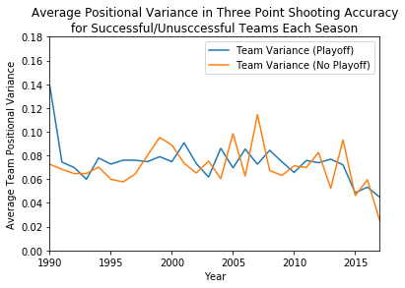



Maximizing Team Potential: Challenging All Positions to Shoot Threes
Early 2000s basketball strategy was dominated by teams with players in rigid offensive roles.
Centers provided short-range, high-accuracy shots from under the basket.
Point guards and shooting guards would try passing the ball closer to the basket and take an occasional long-range shot if they had a chance.
To increase unpredictability and improve shooting opportunities, teams tried developing a roster where all players could shoot three pointers, rather than just certain positions.
Observations from the visual:
Since the mid 2000s, the variance in three-point accuracy between positions for all teams is on a downward trend but does not indicate whether a team will have a successful season.
Fluctuations in variance from season to season appear to be greater for unsuccessful teams.

Slide 6
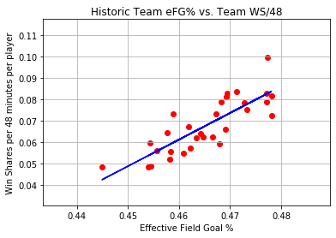
A Well-Oiled Machine: Converting Increased Shot Count into Wins
Effective Field Goal Percentage (eFG%) is a measurement of how successful your team is at shooting the ball from the field.
Provides a more complete picture than standard field goal percentages because three-point shots are given extra weight.
Win Shares per 48 Minutes: This is an advanced stat that builds on win shares, used to determine how much a player contributes to a given win.
This statistic takes into account everything a player does and converts it to a percentage of wins for the team.
Each point on the figure represents an individual NBA franchise, serving as their average from 1990-2017
1
2
r-value = 0.82
Observations from the visual:
San Antonio Spurs:
Franchise W/L Record: 1480/686
Brooklyn / New Jersey Nets:
Franchise W/L Record: 934/1232

Slide 7
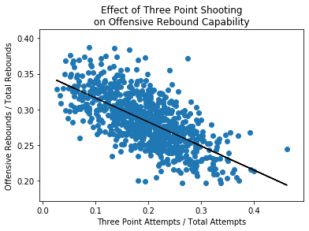
Shooting at a Cost: Three Pointers Affect Offensive Rebounds
While shooting the three-pointer has proven to be a successful team strategy, having teammates in position to attempt these shots - and therefore away from the rim of the basket - hinders that player’s ability to offensively rebound the ball.
Teams and players have both made the decision to adjust strategy and personal skill-sets to adapt to a rapidly-changing offensive environment.
r-value = -0.66

Slide 8
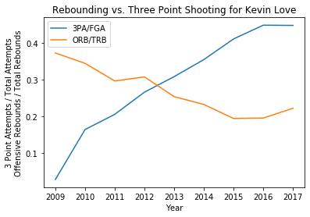
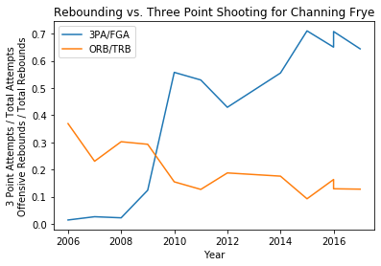
Shooting at a Cost, Part 2: A More Personal Look at Changing Roles
r-value = -0.66

Slide 9
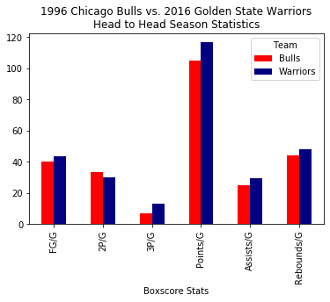
A Traditional Look at Two of the Best Teams

Slide 10
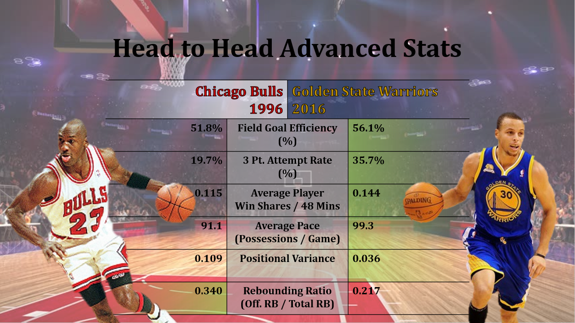

Slide 11
A Tale of Two Eras: Basically One NBA-Shoe-Sized Learning Process
Much of the work on the project was devoted to finding good datasets and learning how to draw
Compiling and merging the Player Data CSV and Season Data CSV required lots of cleanup.
“Year” indication needed to be changed from str(“2017-18”) to int(2018).
Franchises have changed locations and names over the years, so some teams needed to be grouped to improve data continuity.
Finding a reliable API or quick player reference required lots of searching, and learning how to use said API took even longer.
Learning how to present data meaningfully presented an unforeseen challenge.
Comparing data with different scales on the same visual carries additional insight, but is difficult to visualize and program
At the end of the day, some data isn’t meant to be visualized in a plot.

Slide 12
Questions?

Slide 13
Sources
Mather, V. (2016, January, 20). How the N.B.A. 3-Point Shot Went From Gimmick to Game Changer. New York Times. Retrieved from URL: https://www.nytimes.com/2016/01/21/sports/basketball/how-the-nba-3-point-shot-went-from-gimmick-to-game-changer.html
“Sportsreference NBA API.” API Documentation - Sportsreference 0.1.0 Documentation, Robert Clark, 2018, sportsreference.readthedocs.io/en/stable/sportsreference.html.
Goldstein, Omri. “NBA Players Stats since 1950.” Kaggle, 27 Apr. 2018, www.kaggle.com/drgilermo/nba-players-stats
Boon, P. “NBA Season Records From Every Year.” Kaggle, 31 Dec. 2017, https://www.kaggle.com/boonpalipatana/nba-season-records-from-every-year

